Slide 1
Decentralize File System (Decentralize Google Drive)

Slide 2
Need of Decentralization?
Control of User Data in hands of Central Location.
Here are Real Life Examples:
Twitter(Elon Musk) verified blue tick for $8.
Social Media Platforms(Twitter, Facebook, Instagram) delete post of user OR even block the user.
User’s personal data is sold to Other Third Party to increase their sales without their permission.

Slide 3
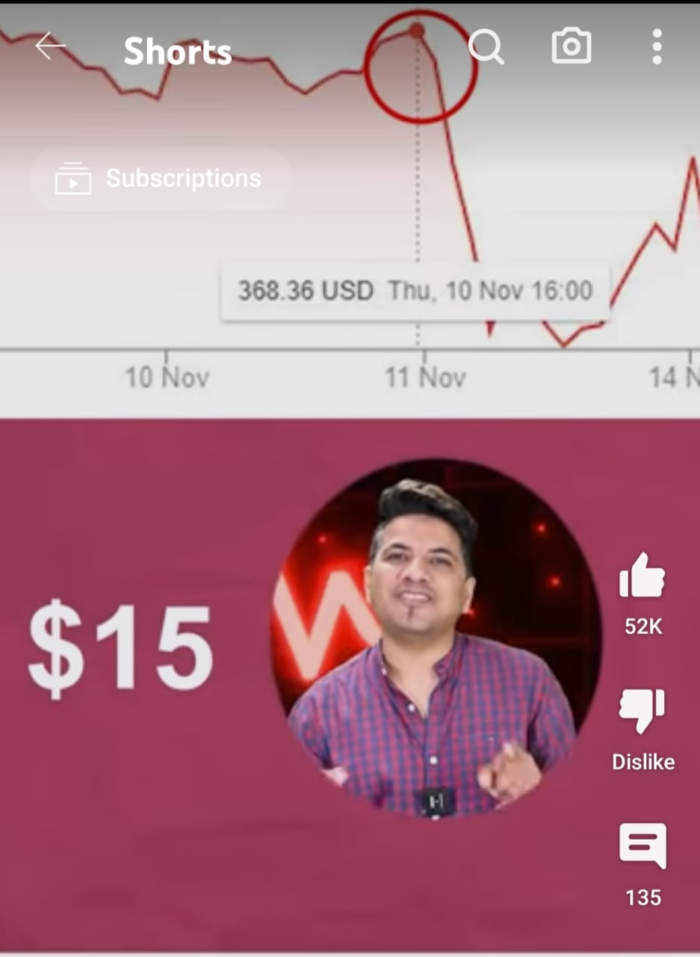
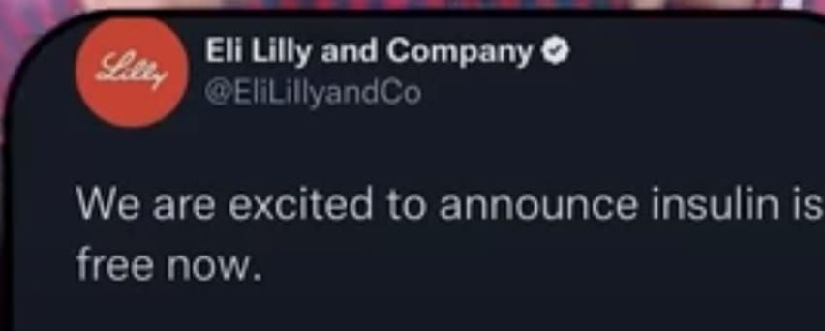

Slide 4
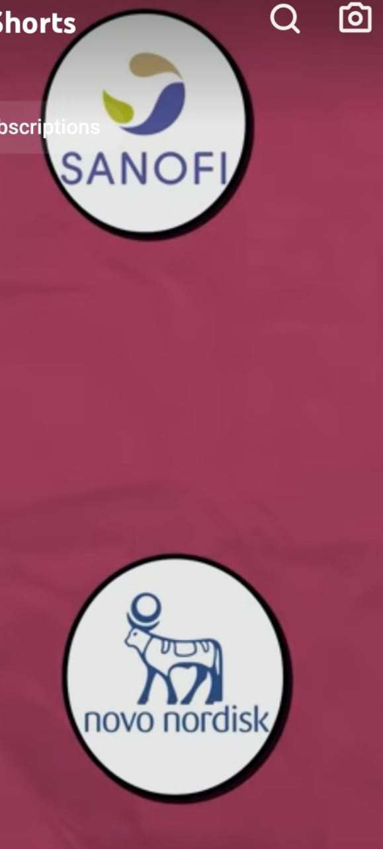

Slide 5
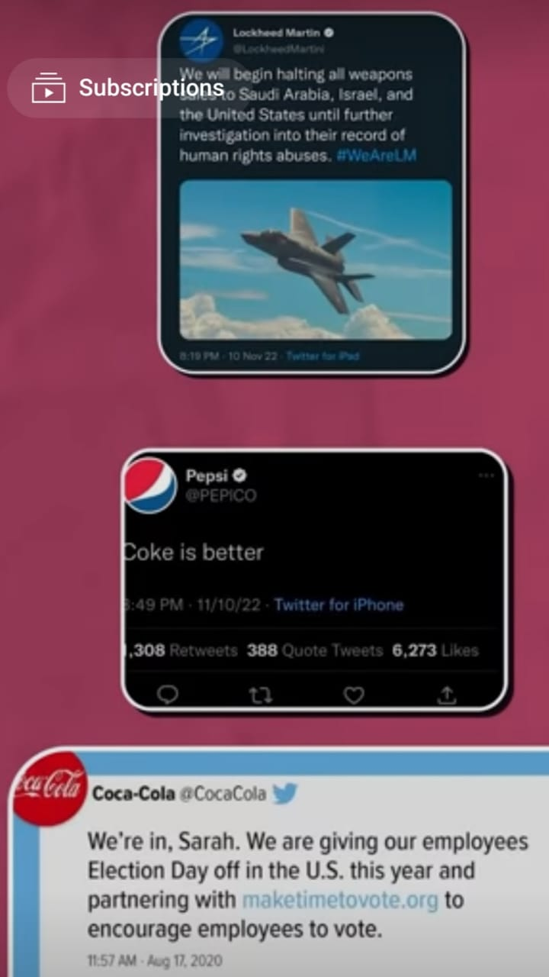
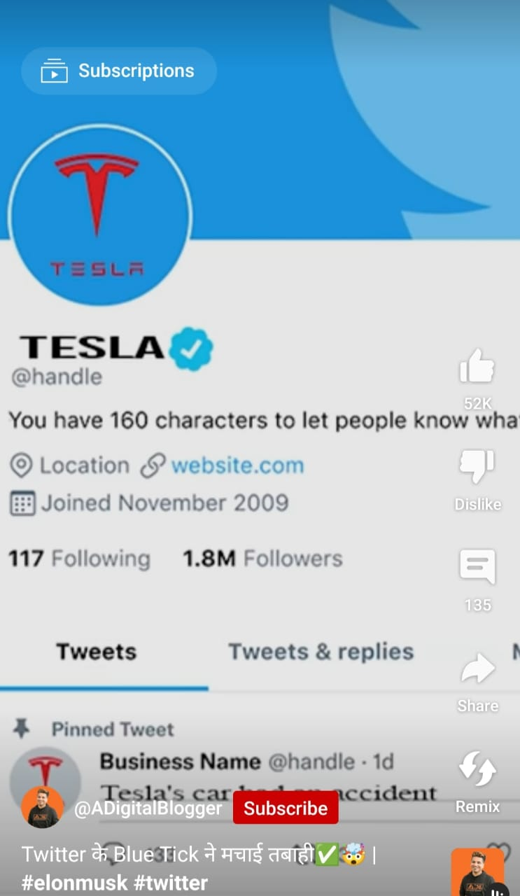

Slide 6
Should We Completely Shift to Decentralization?
Decentralization is not going to Replace Centralization.(User may not be interested in securing his favourite movies, songs and videos freely available on Internet)
It is just an optional choice depending upon the urgue of security of personal identity or private confidential data.

Slide 7
Introduction:
The "Decentralize File System" is a cutting-edge blockchain project inspired by Google Drive. This decentralized platform empowers users to securely upload and share files with others.
Leveraging the InterPlanetary File System (IPFS) for data storage, the system ensures that files are distributed across a network of nodes, eliminating central points of failure. Through Smart Contracts on the blockchain, users can manage file access, encryption, and permissions, guaranteeing data privacy and control.
Embrace a new era of file management with our innovative and decentralized solution, enabling seamless collaboration and data exchange in a trustless environment.

Slide 8
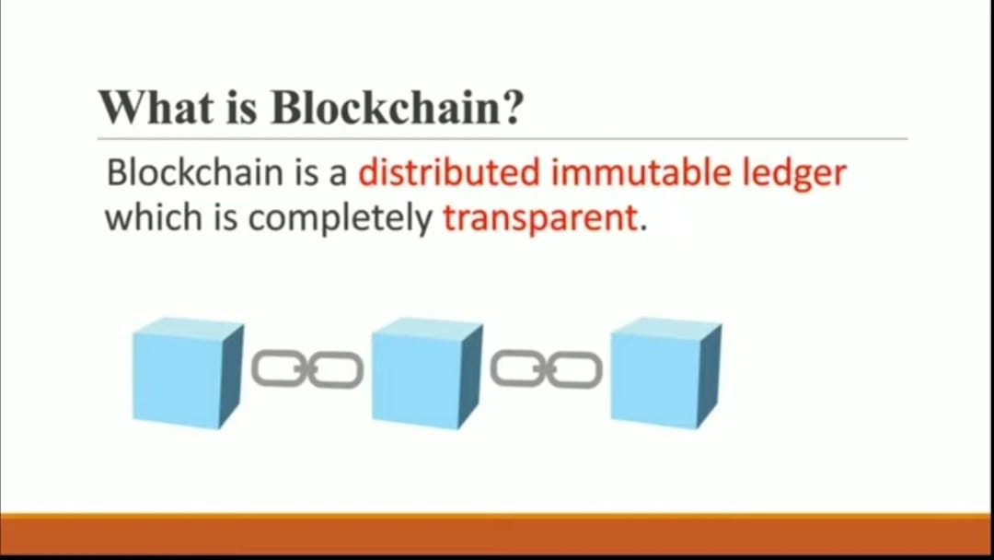

Slide 9
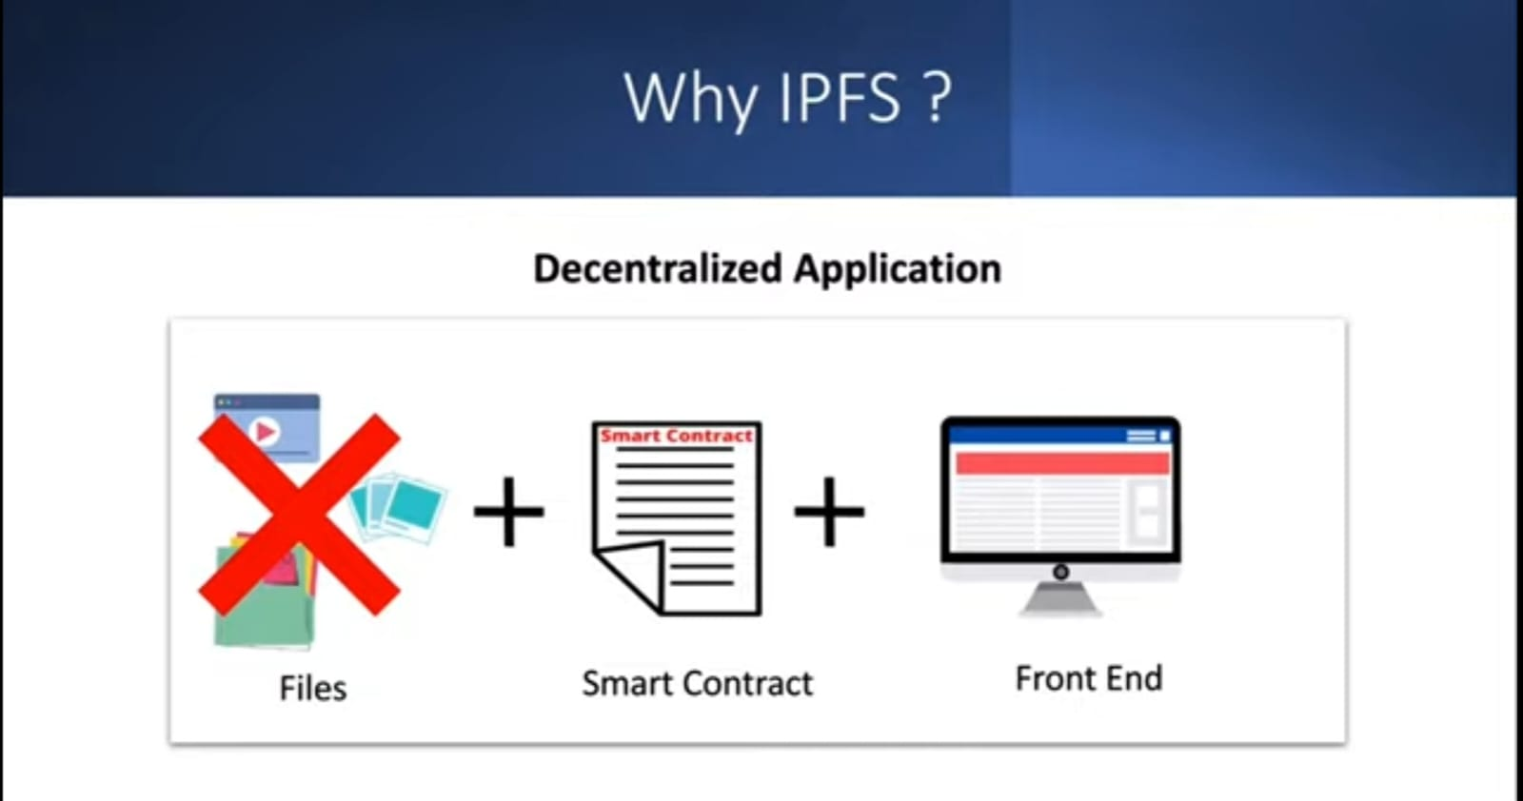

Slide 10
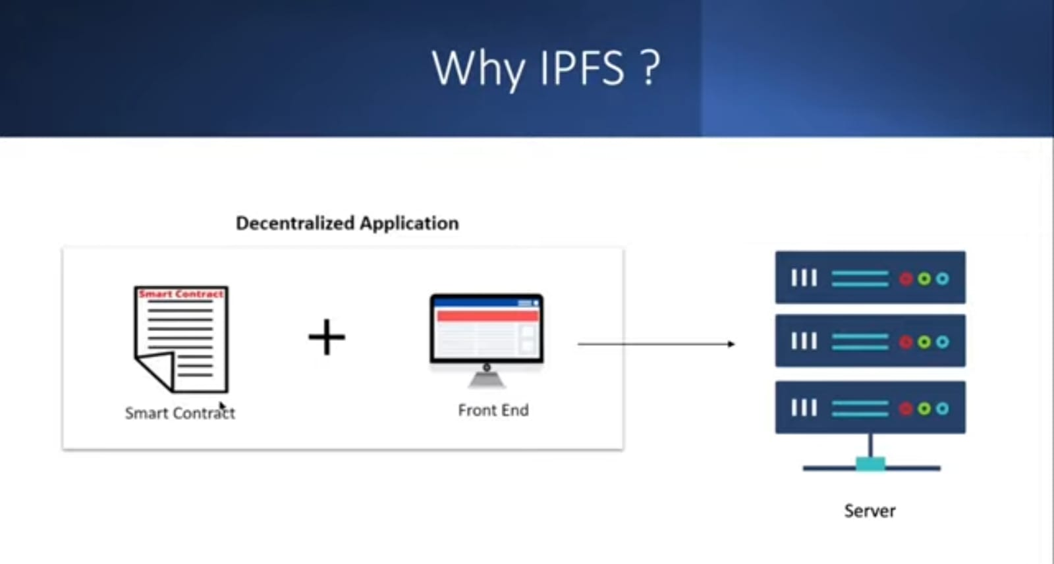

Slide 11
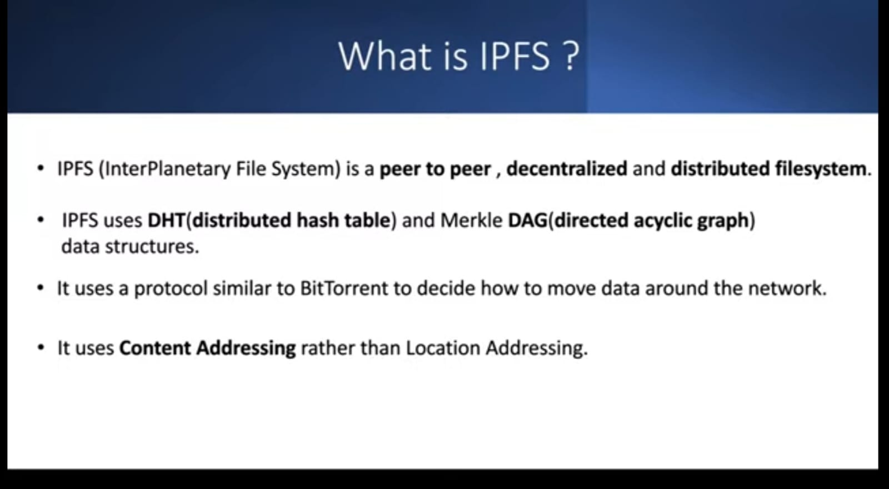

Slide 12
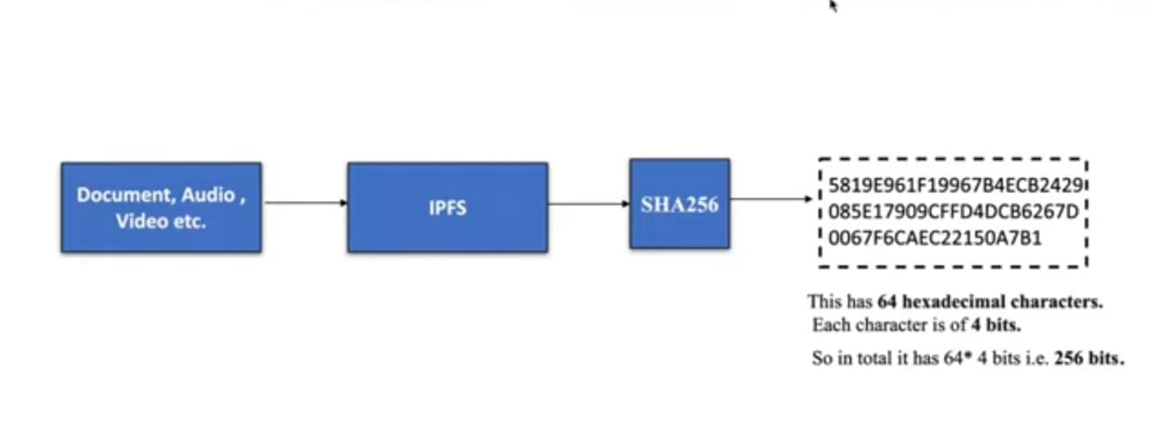

Slide 13
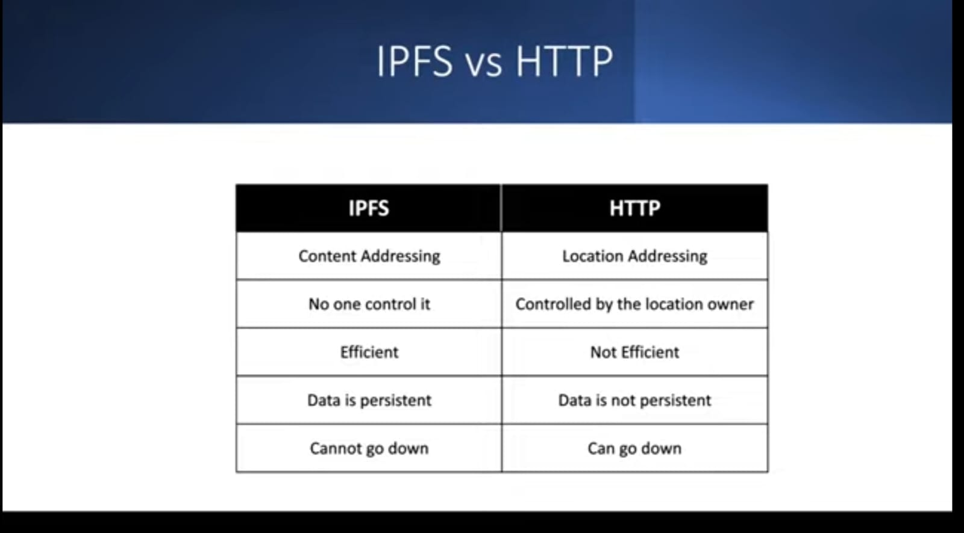

Slide 14
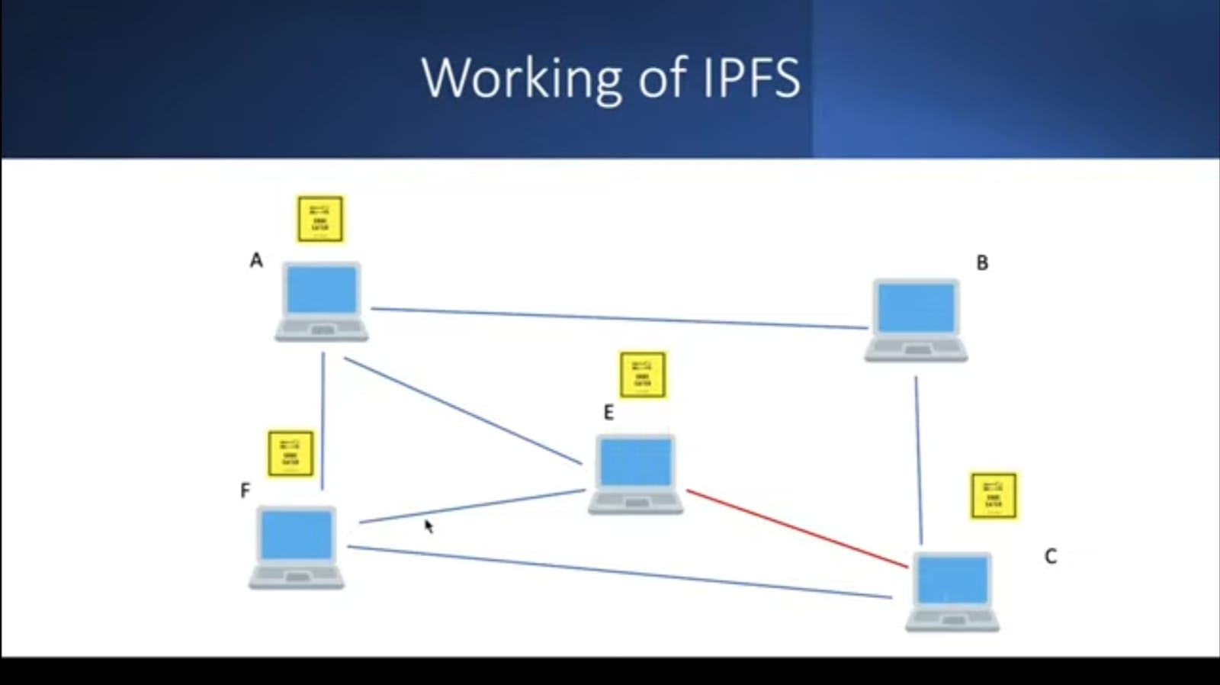

Slide 15
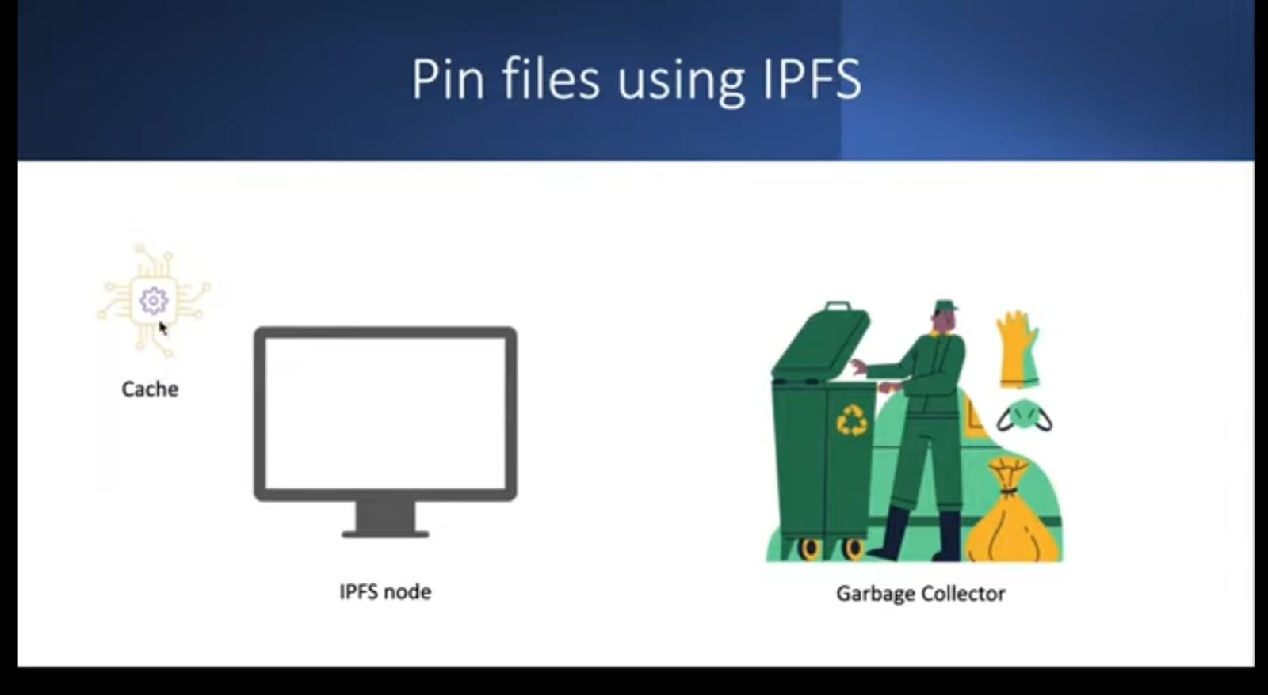

Slide 16
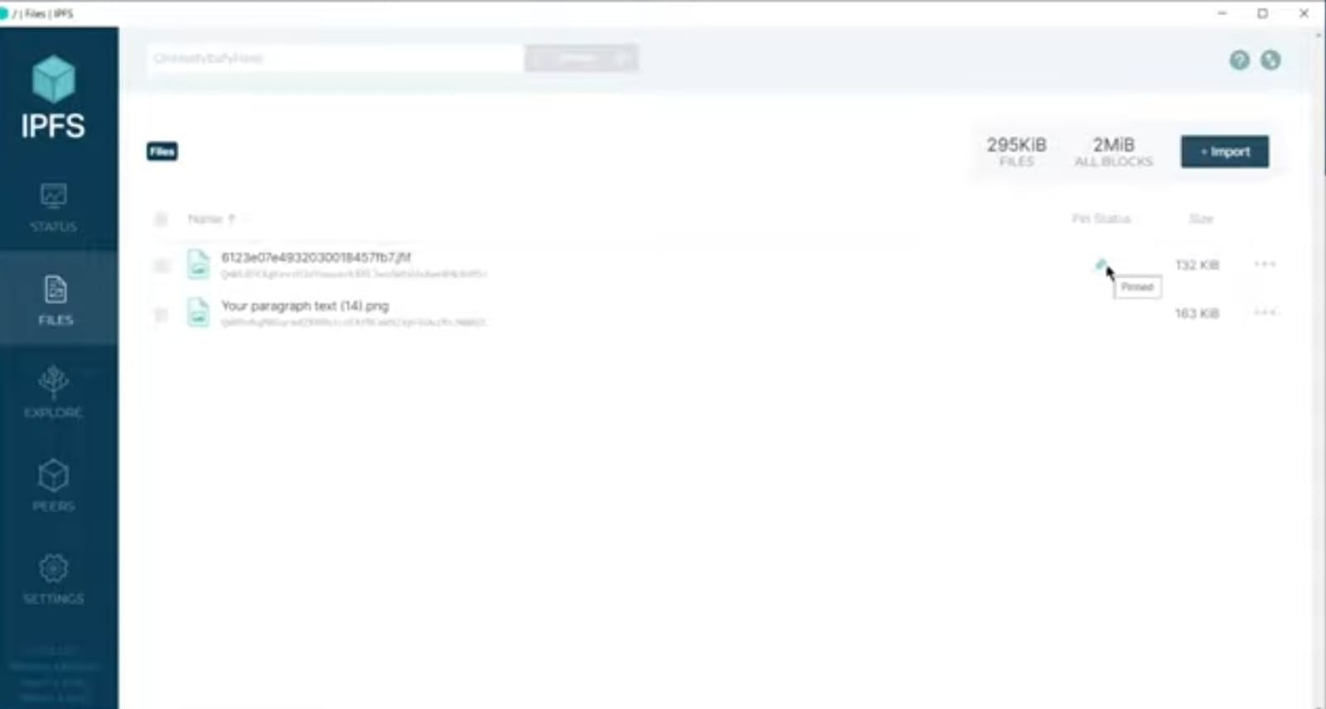

Slide 17
Literature Survey:
Decentralized Cloud Storage Using Blockchain.
(https://ieeexplore.ieee.org/abstract/document/9143004)
Blockchain-Based, Decentralized Access Control for IPFS.
(https://ieeexplore.ieee.org/abstract/document/8726493)
When Blockchain Meets Distributed File Systems: An Overview, Challenges, and Open Issues.
(https://ieeexplore.ieee.org/abstract/document/9031420)

Slide 18
Problem Statement:
Develop a decentralized file system that addresses the limitations of traditional cloud-based storage solutions like Google Drive. The project aims to provide users with full control over their data and a secure and efficient platform to upload, store, and share files in a decentralized manner using IPFS. By leveraging blockchain technology, the system should enable users to maintain ownership and control over their data while allowing seamless and permission-controlled file sharing with others. The project seeks to create a file management solution that ensures data privacy and accessibility in a decentralized environment.

Slide 19
Hardware and Software Requirement
Hardware
Computer/Server:
Processor (CPU):
RAM:
Internet Connectivity:
Software
Html,CSS,Javascript
Etherium
IPFS
Solidity
Web3 Libraries
Smart Contract-Based Authentication
Metamask
Ganache
Truffle

